Slide 1

Plant Classification
capstone Presentation
Daniel Vitale
Binbin wu

Slide 2
INTRODUCTION
Plant species are difficult to identify in the wild. Plant identification in ecological surveys is a tremendous task which requires high levels of expertise, manpower, and time. To this end, we are seeking to develop a plant identification software to identify species from images with high accuracy.
Expenditures on endangered species conservation plans total more than $800 million annually and include 218 plant species
Department of Defense (DoD) has the highest density of endangered species of any other federal agency, with 340 out of 420 large military installations requiring active conservation management plans to protect 492 listed species (274 animals, 218 plants).

Slide 3
PROBLEM STATEMENT
There are several significant complications in the development of such a technology:
Tremendous species variability
Vast intra-species morphological differences
Many inter-species similarities.
Many unclassified species
vast differences across image data from different sources.
Difficult to differentiate between species in mixed photos.
Project focus is to save conservation resources by developing a simple automated system for uploading large folders of images, identifying species in images, and sorting based on prediction

Slide 4
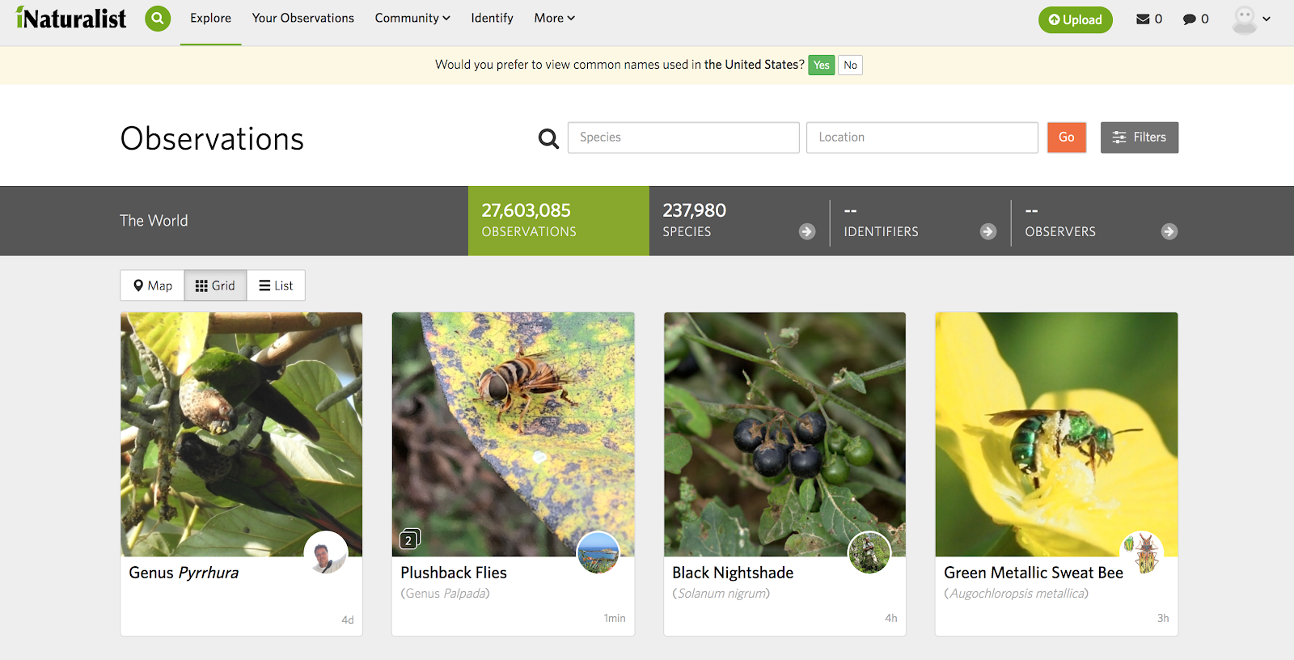
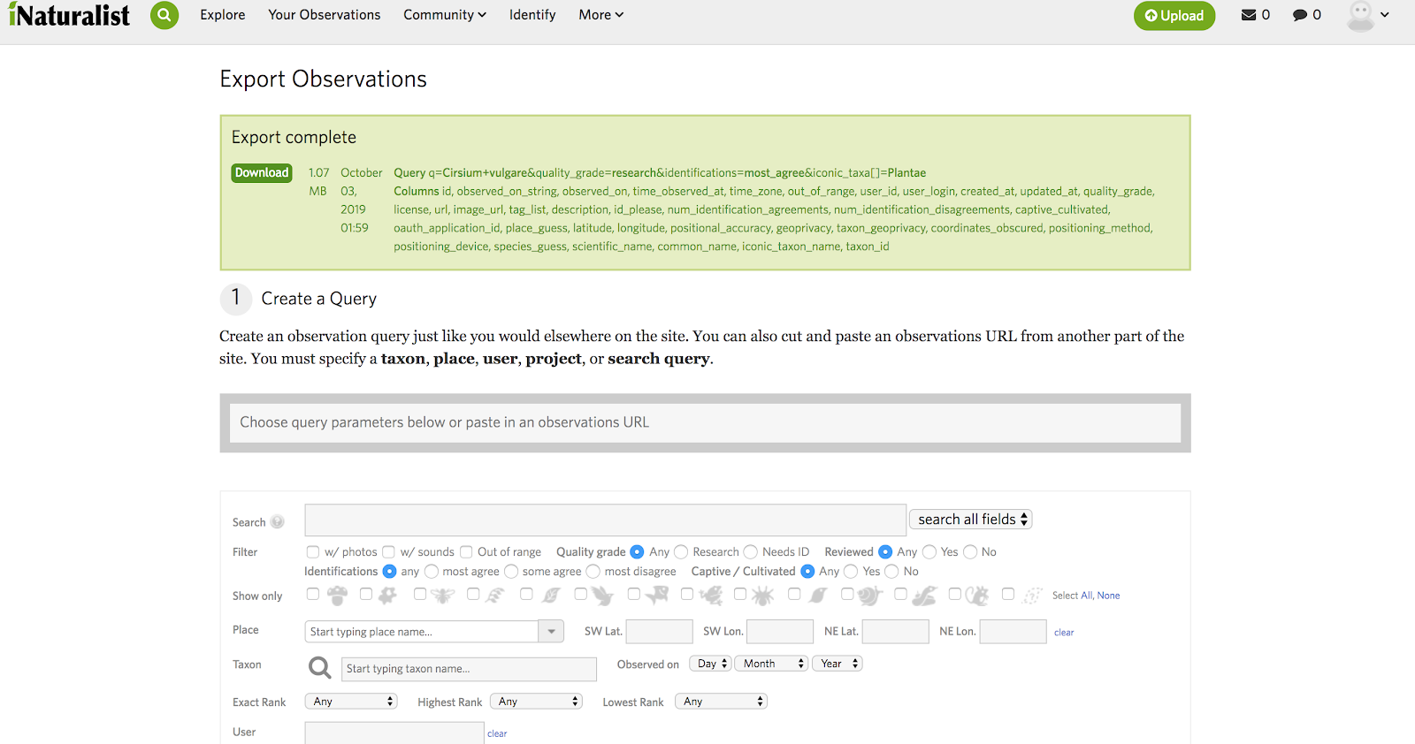
DATASET
We are using images from iNaturalist.org. We acquire their image data using the website query system, since The site stated the API cannot handle large requests. For testing the model, we have 300 images of 10 different plant species.
iNaturalist is a citizen science project and online social network of naturalists, citizen scientists, and biologists built on the concept of mapping and sharing observations of biodiversity across the globe. iNaturalist may be accessed via its website or from its mobile applications.

Slide 5
DATASET
We start with 10 different plant species, and 300 images pre-class for train, 100 for validation ,100 for Testing, even class distribution
Then Move on with 20 different plant species, and 3000 images pre-class, 1000 for validation, 1000 for Testing, even class distribution. we COULD HAVE MORE IF WE HAVE ENOUGH COMPUTING POWER
red clover
Trifolium pratense
Virginia spring beauty
Claytonia virginica

Slide 6
INITIAL DATA AUGMENTATION
INITIAL 300 Images some were rotated 90 ̊, 180 ̊
Some were horizontally flipped and vertically flipped to create more uniform class distributions
All Gray, HSV, edge detection, BINARY THRESHOLD
total images from INITIAL training set: 1500 training,100 testing, 100 validation pre-class.
As a Result of unsuccessful results, instead of simply augmenting the image we decide increase the data for each class.

Slide 7
IMAGE PREPROCESSING: Lanczos
Due to various image size and processing speed of the models, we are using lanczos to resize the image and maintain as much features as possible from the the images.
Evidently, Lanczos resampling is not a panacea or omnibus solution to resampling. It is superior to many other convolution resamplers in maintaining (or even enhancing) local contrast. This can be useful when the resampled image is intended for viewing identification of detailed features or boundaries
Upsampling
Downsampling

Slide 8
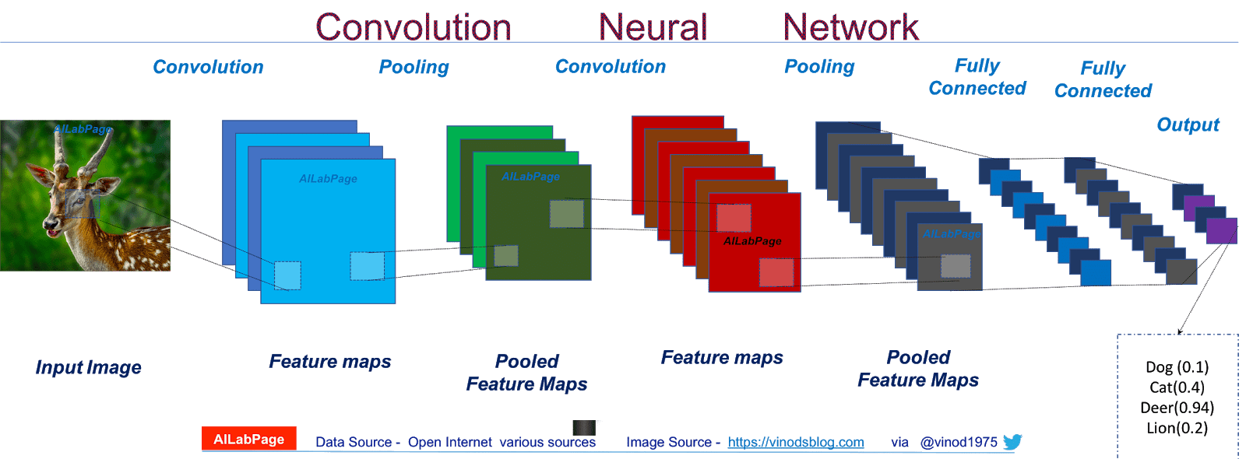

Convolution Neural Network
• Convolutional Layers
Stride over image with various number of weight matrices to detect edges and patterns
Parameters include: Kernel Size, Stride, Padding
• Activation
• ReLU()
• Max Pooling Layers
• Shrink images based on maximum
value in kernel
• Flatten
• Flatteninto1darray
• Fully Connected Layer
• Fully connected layer
• Softmax Output
• Classprobability

Slide 9
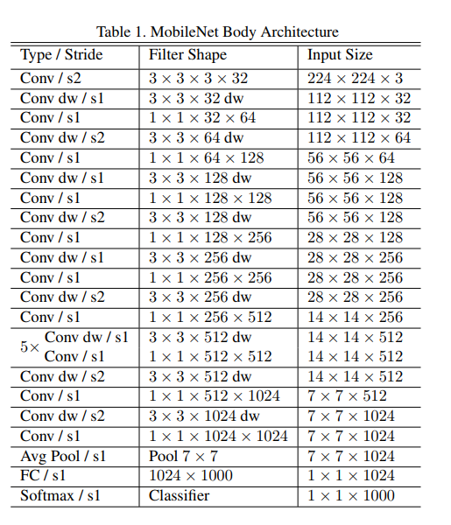
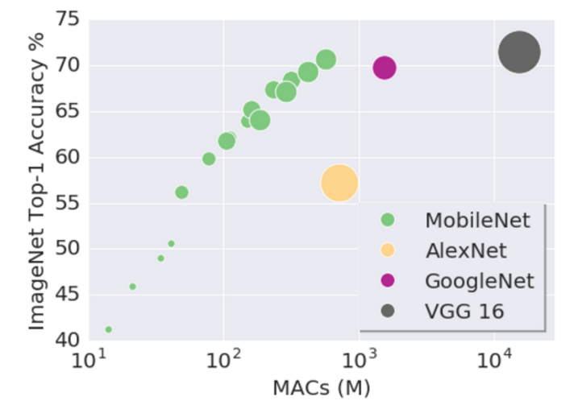
Pretrain Model: MobileNet
MobileNet is 21 Convolutional layers network, we change the input size, and take out the fully connected layer from original network and attached FC-1024, FC-1024, FC-512, FC-20 SOFTMAX
The reason using MobileNet is the speed and power.
The speed and power consumption of the network is proportional to the number of MACs (Multiply-Accumulates) which is a measure of the number of fused Multiplication and Addition operations

Slide 10
More Model information
Additional layer for MobileNet:
Basic Model Layer :
Conv2D
Activation(Relu)
Conv2D
Activation(Relu)
Conv2D
Activation(Relu)
Conv2D
Activation(Relu)
Flatten(800)
FC(512)
FC(256)
Dropout(0.2)
MaxPooling (2,2)
Layer (type) Output Shape Param #
dense_1 (Dense) (None, 1024) 1049600
___________________________________________________________
dense_2 (Dense) (None, 1024) 1049600
___________________________________________________________
dense_3 (Dense) (None, 512) 524800
___________________________________________________________
dense_4 (Dense) (None, 20) 10260
============================================
Total params: 5,863,124
Trainable params: 5,827,220
Non-trainable params: 35,904
===================
Total params: 593,140
Trainable params: 593,140
Non-trainable params: 0
_________________________
Dropout(0.2)
MaxPooling (2,2)
Dropout(0.2)
MaxPooling (2,2)
Dropout(0.2)
MaxPooling (2,2)
Activation(Relu)
Dropout(0.2)
Softmax(20)

Slide 11
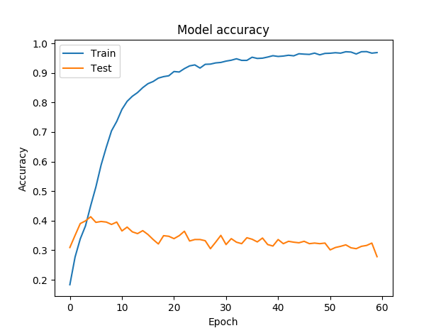
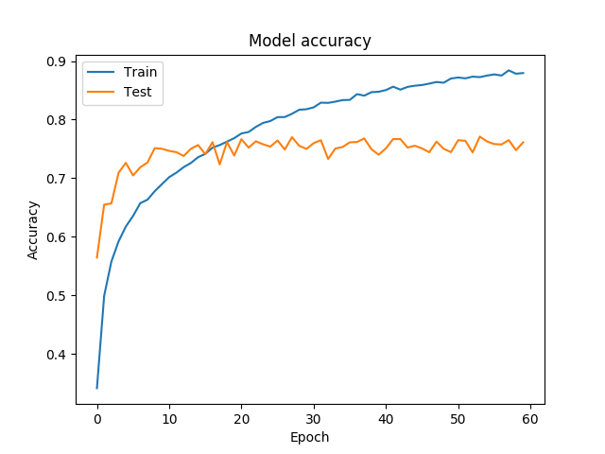
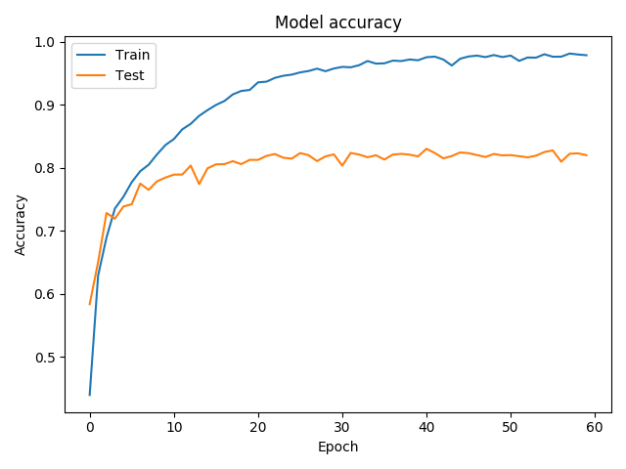
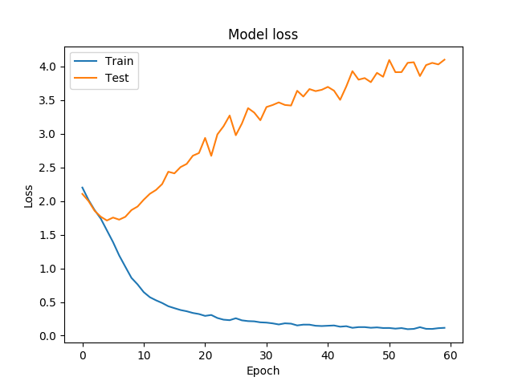
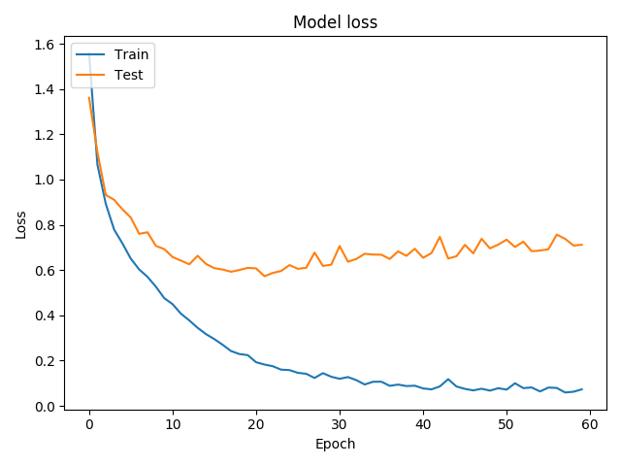
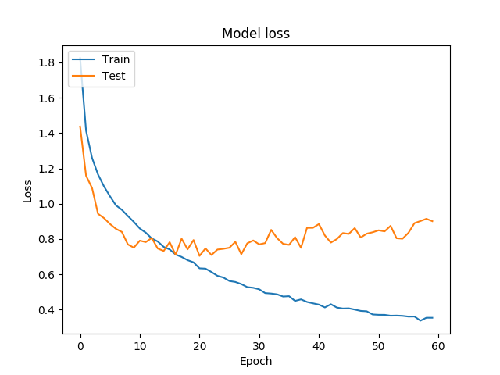
Basic Model : Data Size, augmentation, preprocessing
Lowest amount of data with data augmentation, preprocessing
Large amount of data with data augmentation
Large amount of data with data augmentation, preprocessing

Slide 12
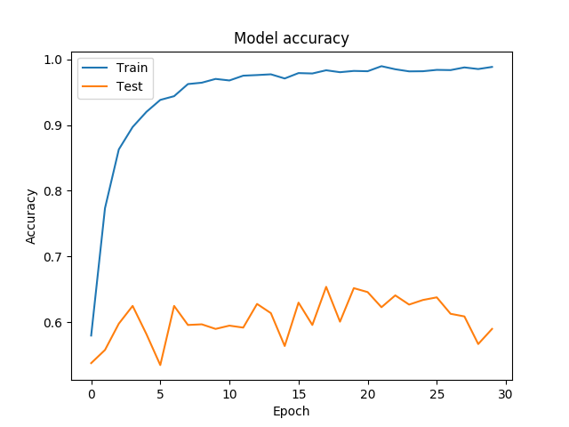
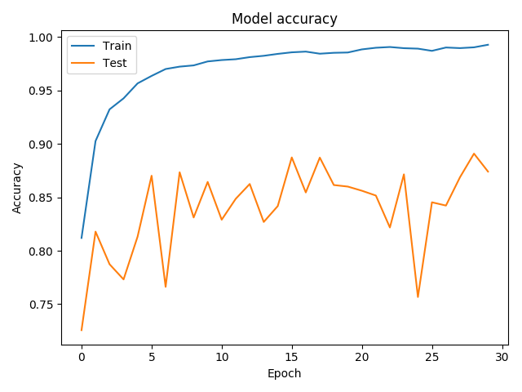
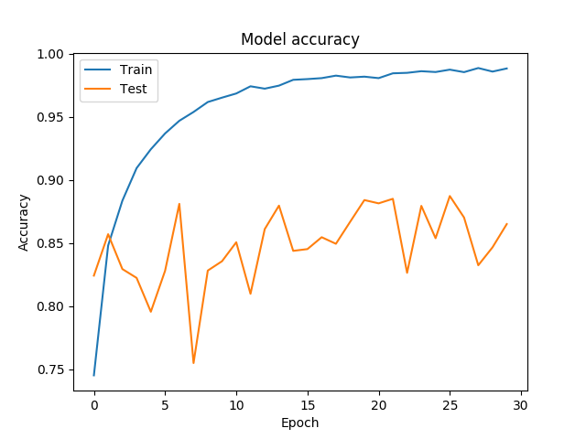
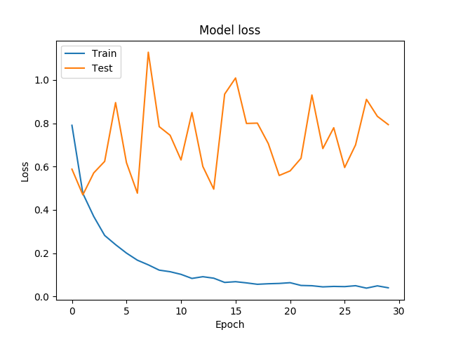
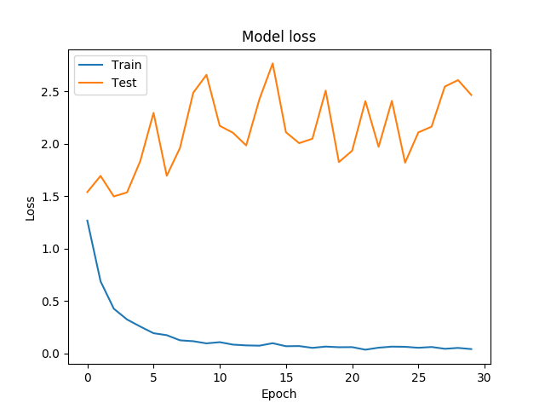
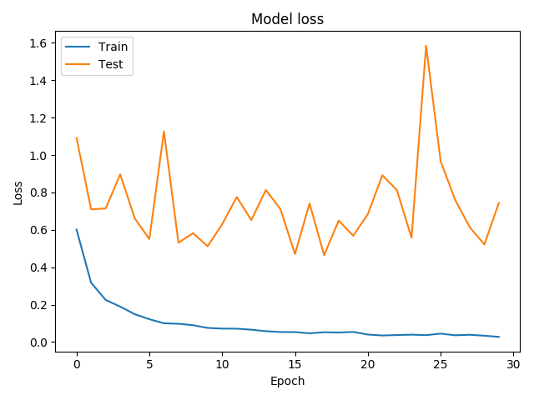
MobileNet : Data Size, augmentation, preprocessing
Lowest amount of data with data augmentation, preprocessing
Large amount of data with data augmentation
Large amount of data with data augmentation, preprocessing

Slide 13
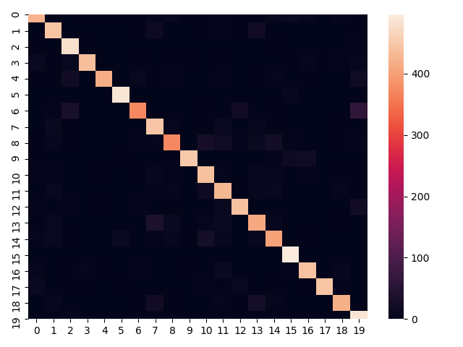
Model Classification Metric
Classification Report
precision recall f1-score support
Asclepias tuberosa 0.87 0.85 0.86 500
Cercis canadensis 0.85 0.89 0.87 500
Cichorium intybus 0.84 0.96 0.90 500
Cirsium vulgare 0.96 0.87 0.92 500
Claytonia virginica 0.97 0.84 0.90 500
Gaillardia pulchella 0.95 0.97 0.96 500
Glechoma hederacea 0.90 0.74 0.82 500
Liquidambar styraciflua 0.80 0.89 0.84 500
Lonicera japonica 0.85 0.74 0.79 500
Lotus corniculatus 0.97 0.90 0.94 500
precision recall f1-score support
Parthenocissus quinquefolia 0.83 0.88 0.85 500
Phytolacca americana 0.79 0.86 0.83 500
Prunella vulgaris 0.90 0.88 0.89 500
Prunus serotina 0.80 0.82 0.81 500
Rosa multiflora 0.82 0.81 0.81 500
Rudbeckia hirta 0.90 0.99 0.94 500
Taraxacum officinale 0.90 0.89 0.89 500
Trifolium pratense 0.98 0.89 0.93 500
Verbascum thapsus 0.90 0.84 0.87 500
Viola sororia 0.78 0.97 0.87 500

Slide 14
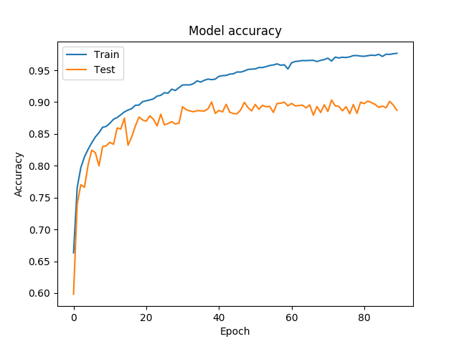
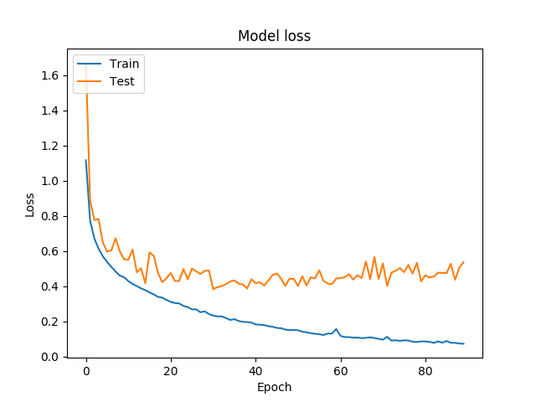
Final Model
3000 images pre-class, 20 class (with ability to add more)
some data augmentation (rotation, flipped, zoom)
preprocessing (lanczos)
MobileNet + GAP + 2 FC layer (all layer trainable)
• Full preprocessing produced best results at:
89.2% accuracy
87% recall
88% precision
87% F1

Slide 15
Limitation & Improvement
1.Using ImageDataGenerator in Keras, CPU bottlenecks can be significant. Basically, the CPU is loading data into RAM, and then applying a number of transformations prior to offloading it to the GPU.
2.Using The original images has various size, we had to resize it which potentially cost us some feature. If we take the image at it’s original size we might have better results, but it will take way longer to train.
3. The data does have label information about stage of life of the plant, which could help to classify all the plant even better.

Slide 16

FLASK APPLICATION
Python micro web framework to develop web applications
Connect frontend HTML and JavaScript with backend Python using templates and connect pages using route decorators
Upload files through upload bar, run each image in file through model, output graphics, and sort on local file system

Slide 17

Summary
Comparing: • preprocessing
• augmentation
• data size
• network model
Best Model:
• 89.2%accuracy
Analyzing the network
• overfitting
• recall
• precision
Possible Improvement
• Training without resizing • More classes to see the limit of the model
• Having additional labels such as stage of life
Web Application
• People can upload image and get ID the plant class
Testing:
• Model Training Time • premasters trained

Slide 18
QUESTION?

